Slide 1

Online Education System
Majed aljunaidy ameen abu-alhasan Emran alzoubi

Slide 2
Data description and dependencies
- All needed libraries and importation of the data
- Types of columns and data size
- What does our study aim for?

Slide 3
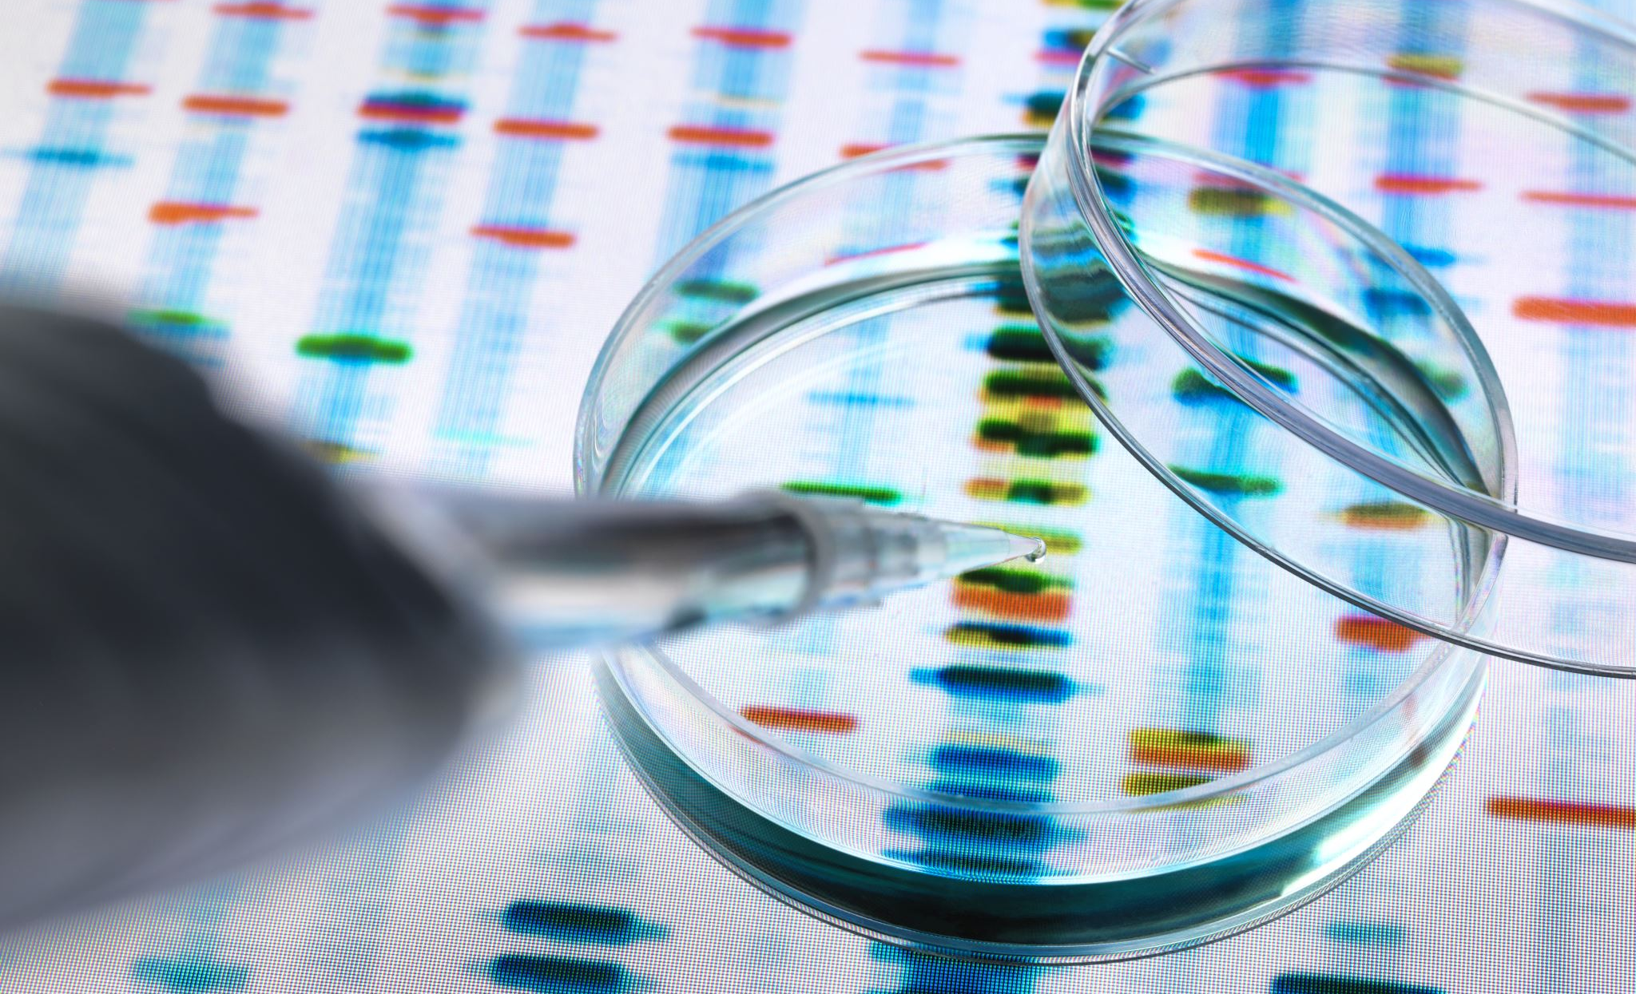
Statistical and Categorical analysis
The study of single or multi-feature

Slide 4
Cont…
What describe function do? | Values meaning

Slide 5
Cont..
- Clarify all our researching and scrutiny on the data
- Explain all the plots made and how we coded it
- Show the decision-making data we extracted

Slide 6
Machine learning and it’s requirements
- Encoding : how it works and used for what.
- Scaling : what s scaling?
- Normalization : What is normalization?

Slide 7
Scaling vs Normalization
Mainly Normalization is highly affected by outliers. Standardization is slightly affected by outliers. Normalization is considered when the algorithms do not make assumptions about the data distribution. Standardization is used when algorithms make assumptions about the data distribution.
Outliers are an observation that lies an abnormal distance from other values in a random sample from a population.
Scaling makes the summation of the data equal to zero, normalization make the data in [0, 1] range.

Slide 8
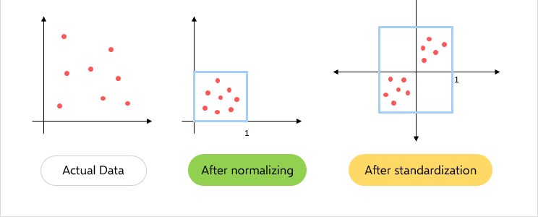
Scaling vs Normalization

Slide 9
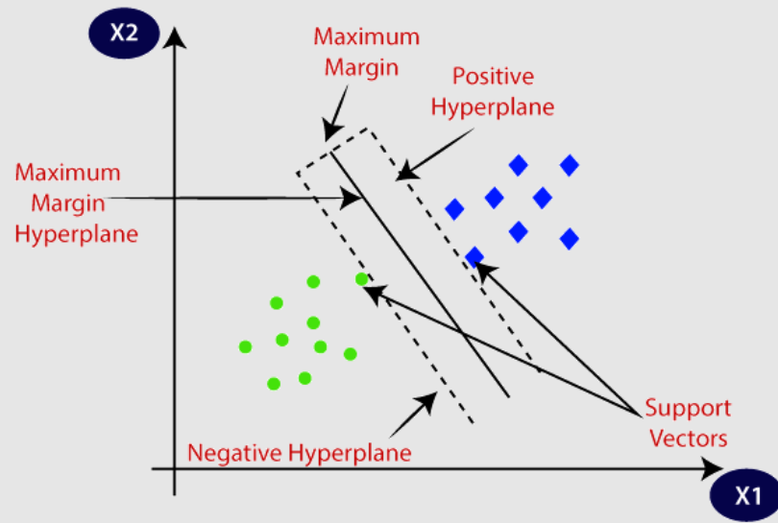
SVM
The objective of the support vector machine algorithm is to find a hyperplane in an N-dimensional space that distinctly classifies the data points.
A hyperplane is a decision boundary that differentiates the classes in SVM

